Slide 1

K-means clustering
National Institute of Technology Sikkim
Machine Learning – CS16104
Course Guide: Dr. Hemant Kumar Kathania
Presented BY : GROUP-5
Vanka Janaki Rama Santhosh - B190044EC
ANDI VIVEK - B190046EC

Slide 2
Contents
INTRODUCTION
WHAT IS K-MEAN CLUSTERING
TRAINING PROCESS OF K-MEANS CLUSTERING
ELBOW METHOD
KEY FEATURES OF K-MEANS CLUSTERING
LIMITATIONS AND DISADVANTAGES
APPLICATIONS
CONCLUSION

Slide 3
introduction
Beginning with Unsupervised Learning, a part of machine learning where no response variable is present to provide guidelines in the learning process and data is analyzed by algorithms itself to identify the trends.
It is a known fact that the data and information are usually obscured by noise and redundancy so making it into groups with similar features is the decisive action to bring some insights.
One of the excellent methods in unsupervised machine learning treated for data classification, k-means suits well for exploratory data analysis to understand data perfectly and get inferences from all data types despite the data in the form of images, text content or numeric, k-means works flexibly.

Slide 4
What is k-means clustering?
K-means algorithm explores for a preplanned number of clusters in an unlabeled multidimensional dataset, it concludes this via an easy interpretation of how an optimized cluster can be expressed.
Primarily the concept would be in two steps:
Firstly, the cluster center is the arithmetic mean (AM) of all the data points associated with the cluster.
Secondly, each point is adjoint to its cluster center in comparison to other cluster centers. These two interpretations are the foundation of the k-means clustering model

Slide 5
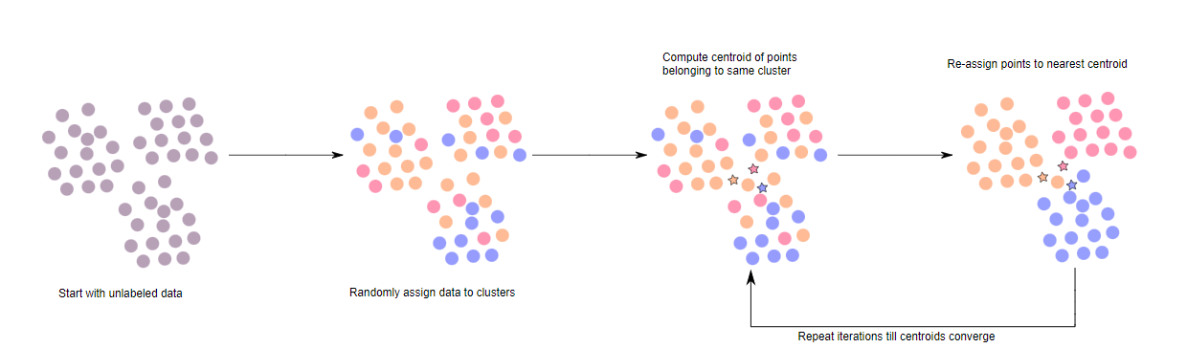
Training PROCESS of k-means clustering

Slide 6
In simple terms, k-means clustering enables us to cluster the data into several groups by detecting the distinct categories of groups in the unlabelled datasets, even without the necessity of data training.
This is the centroid-based algorithm such that each cluster is connected to a centroid while following the objective to minimize the sum of distances between the data points and their corresponding clusters.
Mainly k-means clustering performs 2 tasks:
Calculates the correct value of K-center points or centroids by an iterative method
Assigns every data point to its nearest k-center, and the data points, closer to a particular k-center, make a cluster. Therefore, in each cluster, data points have some similarities and are far apart from other clusters.

Slide 7
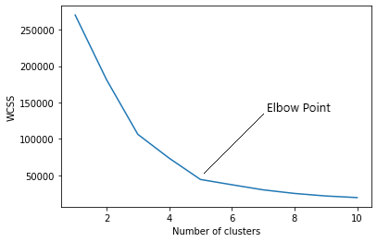
ELBOW method
In the Elbow method, we are actually varying the number of clusters ( K ) from 1 – 10. For each value of K, we are calculating WCSS ( Within-Cluster Sum of Square ). WCSS is the sum of the squared distance between each point and the centroid in a cluster. When we plot the WCSS with the K value, the plot looks like an Elbow. As the number of clusters increases, the WCSS value will start to decrease. WCSS value is largest when K = 1.
When we analyze the graph we can see that the graph
will rapidly change at a point and thus creating an elbow
shape. From this point, the graph starts to move almost
parallel to the X-axis. The K value corresponding to this
point is the optimal K value or an optimal number
of clusters.

Slide 8
Key features
Some key features of k-means clustering are:
It is very smooth in terms of interpretation and resolution.
For a large number of variables present in the dataset, K-means operates quicker than Hierarchical clustering.
While redetermining the cluster center, an instance can modify the cluster.
K-means reforms compact clusters.
It can work on unlabeled numerical data.

Slide 9
limitations
Sometimes, it is quite tough to forecast the number of clusters, or the value of k.
The output is highly influenced by original input, for example, the number of clusters.
An array of data substantially hits the concluding outcomes.
DISADVANTAGES
The algorithm demands the inferred specification of the number of clusters/centers.
An algorithm goes down for non-linear sets of data and is unable to deal with noisy data and outliers.
It is not directly applicable to categorical data since only operatable when the mean is provided.

Slide 10
APPLICATIONS OF K-MEANS CLUSTERING
Academic performance
Search Engines
Wireless sensor networks
Website Traffic Analysis
Market Research
Image Compression

Slide 11
CONCLUSION
K-means clustering is the unsupervised machine learning algorithm that is part of a much deep pool of data techniques and operations in the realm of Data Science. It is the fastest and most efficient algorithm to categorize data points into groups even when very little information is available about data.
More on, similar to other unsupervised learning, it is necessary to understand the data before adopting which technique fits well on a given dataset to solve problems. Considering the correct algorithm, in return, can save time and effort and assist in obtaining more accurate results.

Slide 12
Reference
Wikipedia
Nerchuko/youtube.com
www.analyticssteps.com/blogs/what-k-means-clustering-machine-learning

Slide 13
********** THANK YOU **********

